Slide 1
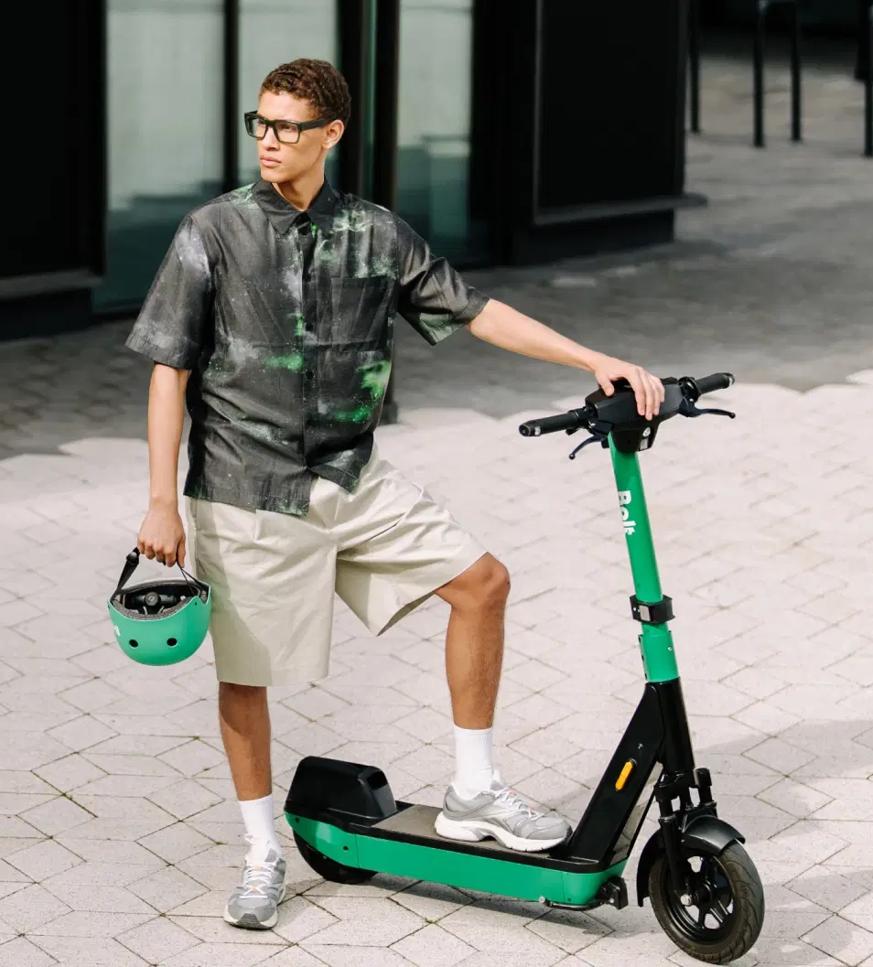
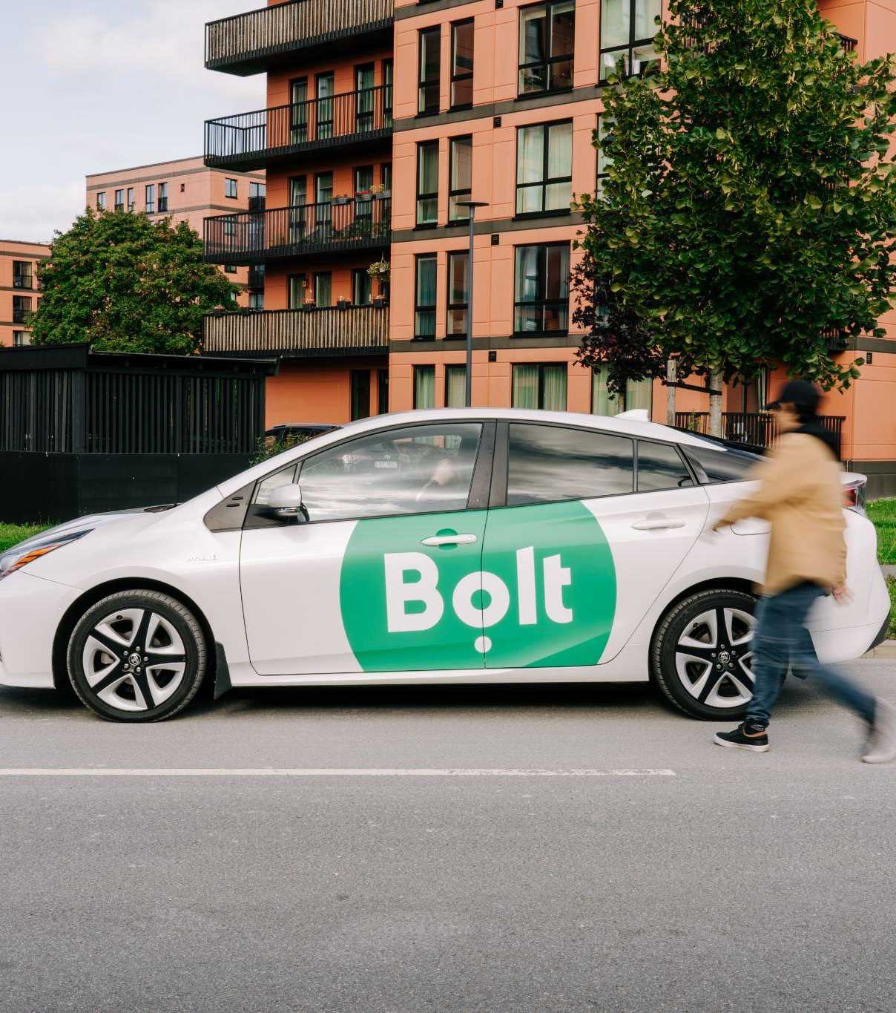
Bolt Rentals
E-Scooter Market Analysis & Strategic Plan
( B A R C E L O N A , 2 0 2 2 )
Prepared by: Emre Özyürek
2025

Slide 2
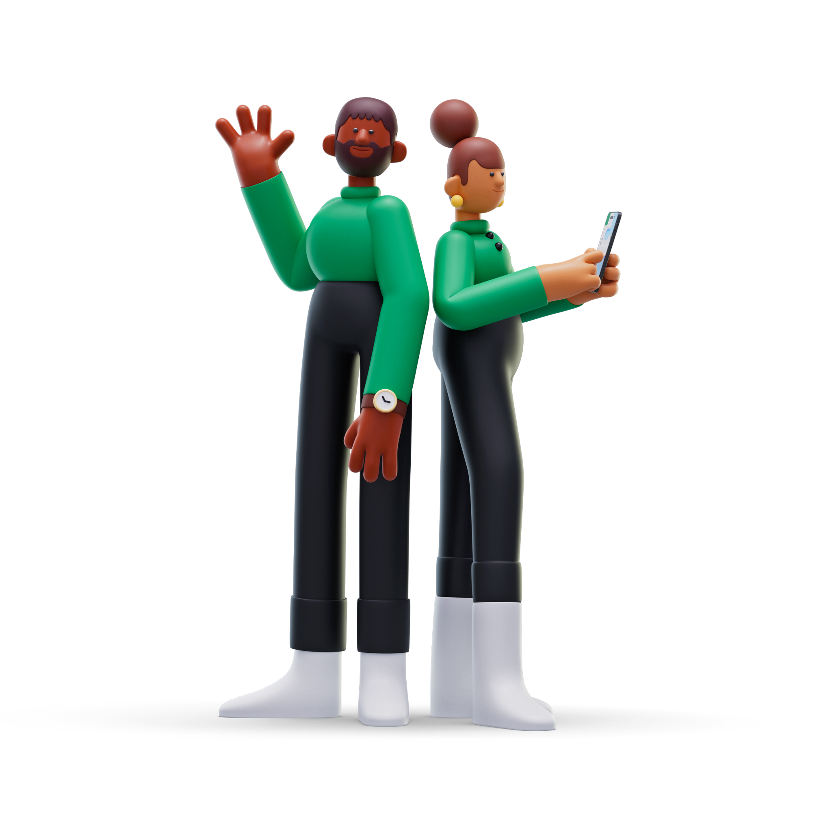

Executive Summary 📌
Bolt aims to enter Barcelona’s e-scooter market in 2022, leveraging its global expertise to capture a significant share of the local market. Key highlights:
Metric | Value | Industry Benchmark
Annual Revenue | €13.1M | ~4.5% of Spain's market
EBITDA Margin | 72.9% | 50–60% (industry avg)
LTV/CAC Ratio | 7.54 | >3 (healthy)
Tourist Contribution | 32% of rides | Critical for Barcelona's tourism economy
Fleet Size | 2,000 (initial) | Scalable to 5,000 based on demand
Market Share Goal | 20% by 2024 | Aggressive but achievable
EMRE ÖZYÜREK

Slide 3
1. Market Size Estimation 📊
1.1 Top-Down Analysis
Metric | Value | Source/Assumption
Spain's 2021 Market | $289.1M | Grand View Research
Barcelona's Share | 10% | Conservative estimate based on population and tourism
Barcelona Market | $28.91M | €24.3M (2022 exchange rate)
Growth Rate | 15% YoY | Industry projections for urban areas
2022 Projected Market | €27.9M | Accounting for growth
EMRE ÖZYÜREK

Slide 4
1. Market Size Estimation 📊
1.2 Bottom-Up Analysis
Metric | Value | Notes
Barcelona Population | 1.6M | 2022 estimate
Target Demographic (18-45) | 40% | 640,000 potential users
E-scooter Adoption Rate | 5% | Conservative estimate
Active Users | 32,000 | Monthly active users
Avg. Rides per User/Month | 8 | Based on similar markets
Monthly Rides | 256,000 | Total estimated rides
Annual Local Rides | 3.07M | Excluding tourists
EMRE ÖZYÜREK

Slide 5
1. Market Size Estimation 📊
1.3 Tourist Impact
Metric | Value | Source
Annual Tourists (2022) | 7.5M | Projected recovery from COVID-19
E-scooter Adoption Rate | 5% | Conservative estimate
Avg. Stay Duration | 4 days | Barcelona tourism statistics
Rides per Tourist | 2 | Assumption based on stay duration
Annual Tourist Rides | 750,000 | Additional to local rides
Total Annual Rides: 3.82M (Local + Tourist)
EMRE ÖZYÜREK

Slide 6
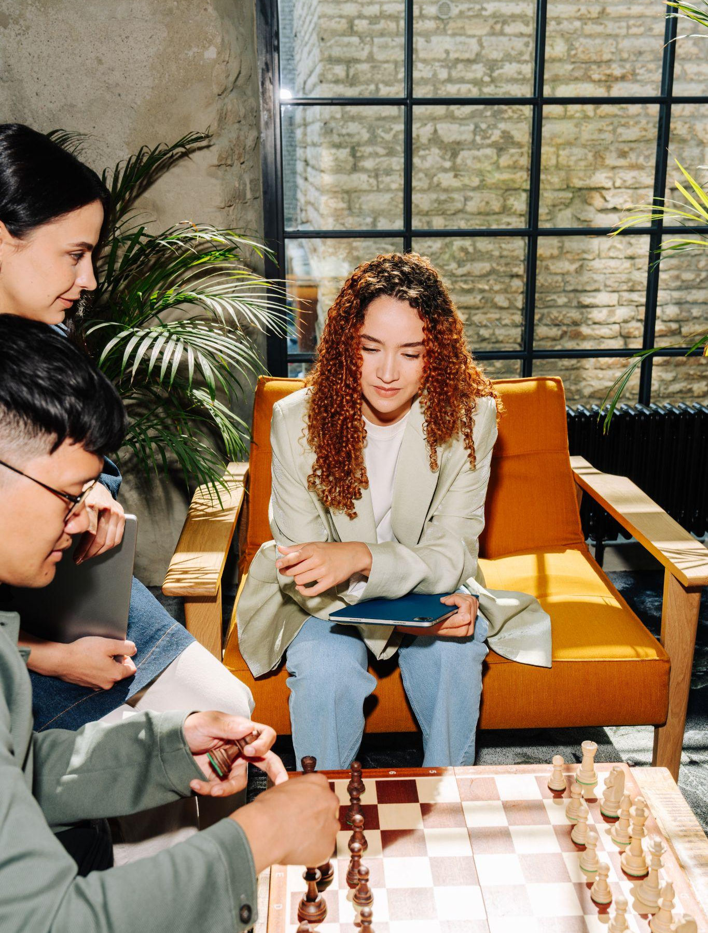
2. Financial Viability (Year 1)
💶
Revenue Streams
Source | Rides | Avg. Price | Revenue
Pay-per-Ride (80%) | 3.056M | €3.00 | €9.17M
Subscription (20%) | 764,000 | €3.50 | €2.67M
Total | 3.82M | - | €11.84M
EMRE ÖZYÜREK

Slide 7
2. Financial Viability (Year 1)
💶
Cost Structure
Cost Item | Calculation | Annual Cost
Scooter Depreciation | €400/scooter, 1.5-year lifespan | €534k
Maintenance | €0.34/ride | €1.30M
Charging | €0.75/scooter/day | €547k
Payment Processing | 2% of revenue | €237k
Staff (20 FTEs) | €35,000/year avg. | €700k
Office & Operations | - | €300k
Marketing | 10% of revenue | €1.18M
Insurance | €100/scooter/year | €200k
Total | - | €4.99M
EBITDA: €6.85M (57.8% margin)
EMRE ÖZYÜREK

Slide 8
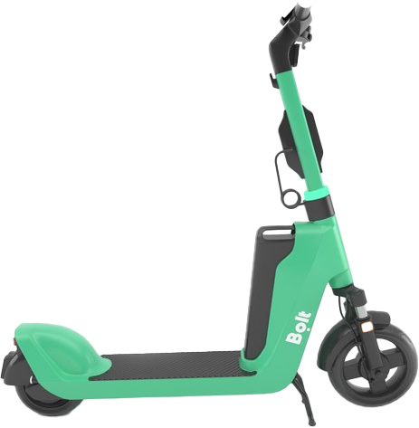
3. Unit Economics 📈
Metric | Value | Industry Avg
Revenue/Ride | €3.10 | €2.80
Cost/Ride | €1.31 | €1.20
Contribution Margin/Ride | €1.79 | €1.60
Rides to Break-Even (Fixed Costs) | 1.12M | -
Customer Acquisition Cost (CAC) | €15 | €20-25
Customer Lifetime Value (LTV) | €113.09 | €90-110
LTV/CAC Ratio | 7.54 | 3-5
EMRE ÖZYÜREK

Slide 9
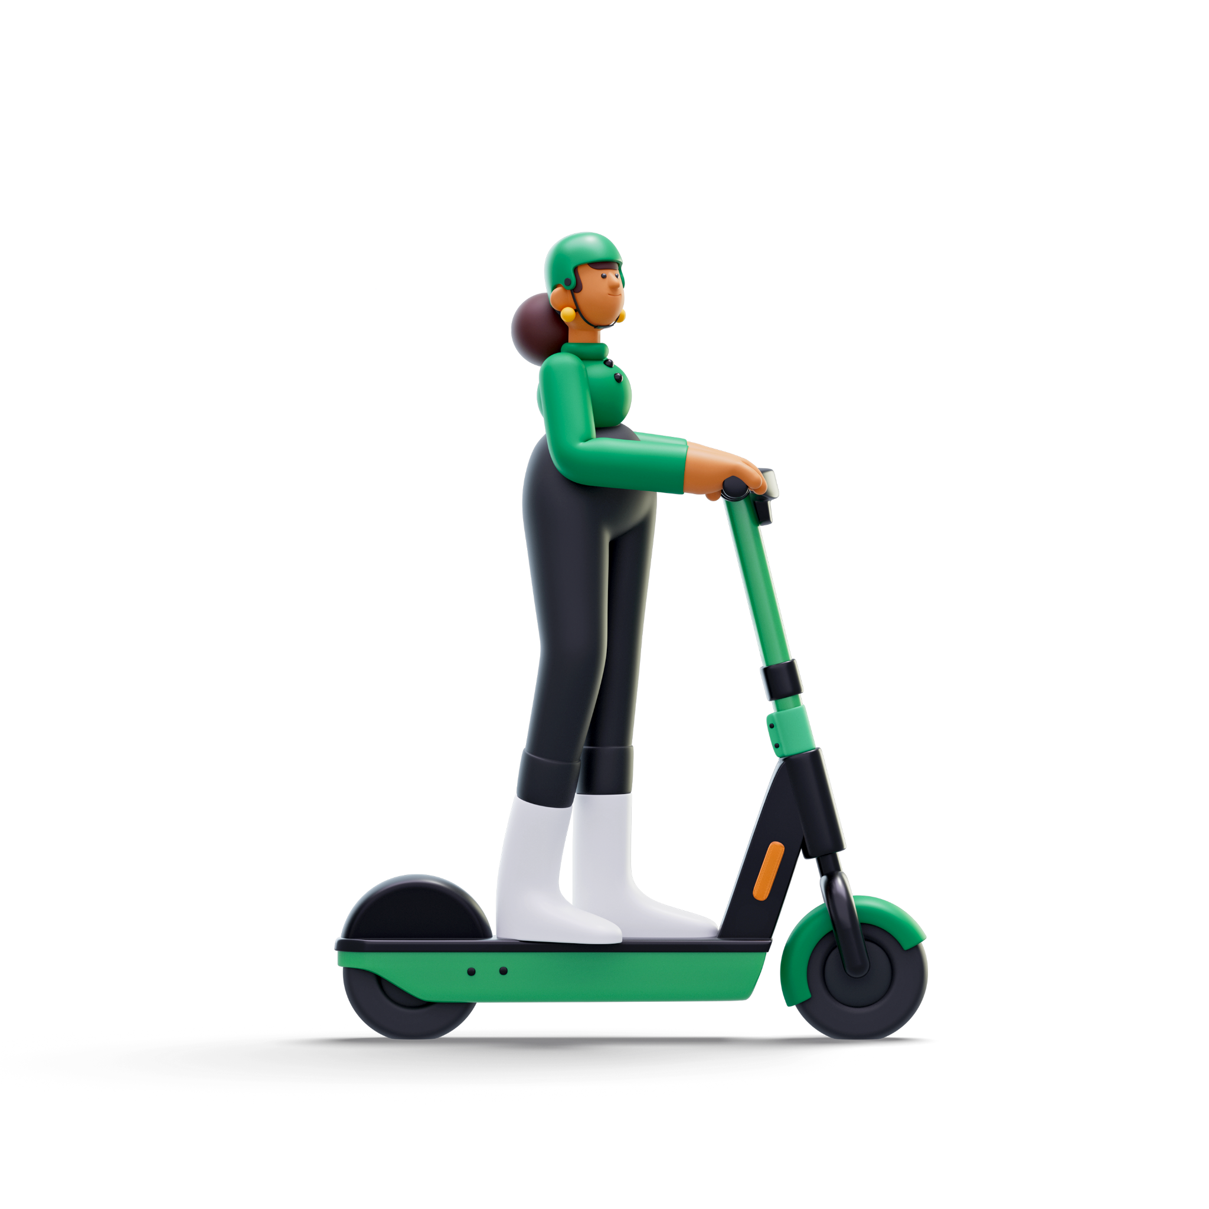





4. Competitive Landscape 🔍
4.1 Key Competitors
Competitor | Pricing (€) | Fleet Size | Key Advantage | Weakness
 | €0.22/min + subs | 2,000 | Global scale, low CAC | New entrant
 | €0.26/min | 5,000 | Established presence | Higher pricing
 | €0.25/min | 1,500 | Vespa-like design | Limited to scooters
 | €0.15/min | 1,000 | Local brand, lower pricing | Smaller fleet
 | €0.28/min | 1,200 | Offers bikes and scooters | Higher pricing
EMRE ÖZYÜREK

Slide 10
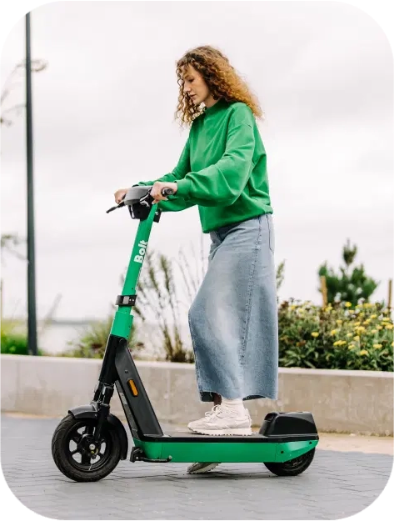
4. Competitive Landscape 🔍
4.2 Regulatory Landscape
Licensing: Limited to 3,975 scooters citywide by AMB (Metropolitan Area of Barcelona)
Parking: Designated zones only, €100 fine for violations
Speed Limit: 25 km/h on bike lanes, 10 km/h on sidewalks
User Requirements: Minimum age 16, single rider only
Insurance: Mandatory third-party liability insurance
EMRE ÖZYÜREK

Slide 11
5. Pricing Strategy 🎯
Phased Approach
Phase | Timing | Pricing Model | Tactics
Entry | Months 1-3 | €0.20/min + free unlocks | 50% off first 5 rides, Referral bonuses
Growth | Months 4-12 | €0.22/min + €0.50 unlock | Dynamic pricing in high-demand areas
Mature | Year 2+ | €0.25/min + premium subs | Loyalty program, Tourist packages
Subscription Plans
Weekend Warrior: €15/month for 120 minutes of weekend rides Daily Commuter: €25/month for 200 minutes, valid Monday-Friday Urban Explorer: €40/month for 400 minutes, anytime use
EMRE ÖZYÜREK

Slide 12
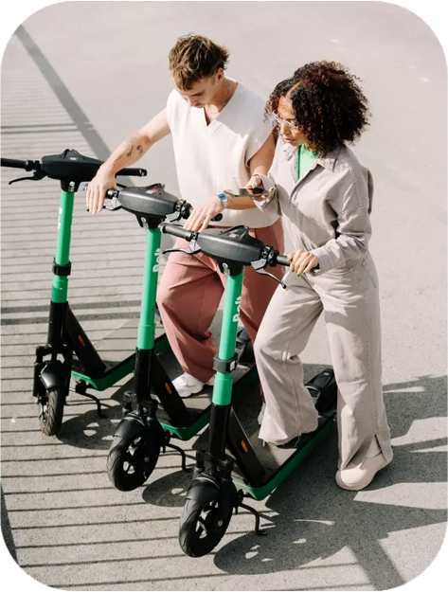
6. Risk Mitigation ⚠️
Risk | Mitigation Strategy
Regulatory changes | Dedicated compliance team, proactive engagement with AMB
Vandalism & theft | GPS tracking, anti-theft alarms, partnerships with local police
Seasonal demand fluctuations | Dynamic fleet management, winter maintenance schedules
Battery life & charging | Swappable batteries, incentivized user drop-offs at charging stations
User safety | In-app safety tutorials, free helmet giveaways, insurance partnerships
EMRE ÖZYÜREK

Slide 13

7. Strategic Recommendations 🗂️
1. Launch Strategy
- Start with 2,000 scooters, focusing on high-traffic and tourist areas. - Scale to 3,500 within 6 months based on demand and regulatory approval.
2. Tech Integration
- Implement AI-driven rebalancing to optimize scooter placement - Develop "virtual docking" using geofencing to ensure proper parking.
3. Partnerships
- Collaborate with Barcelona City Council for sustainable mobility initiatives - Partner with major hotels and Barcelona Tourist Card for integrated offerings.
EMRE ÖZYÜREK

Slide 14

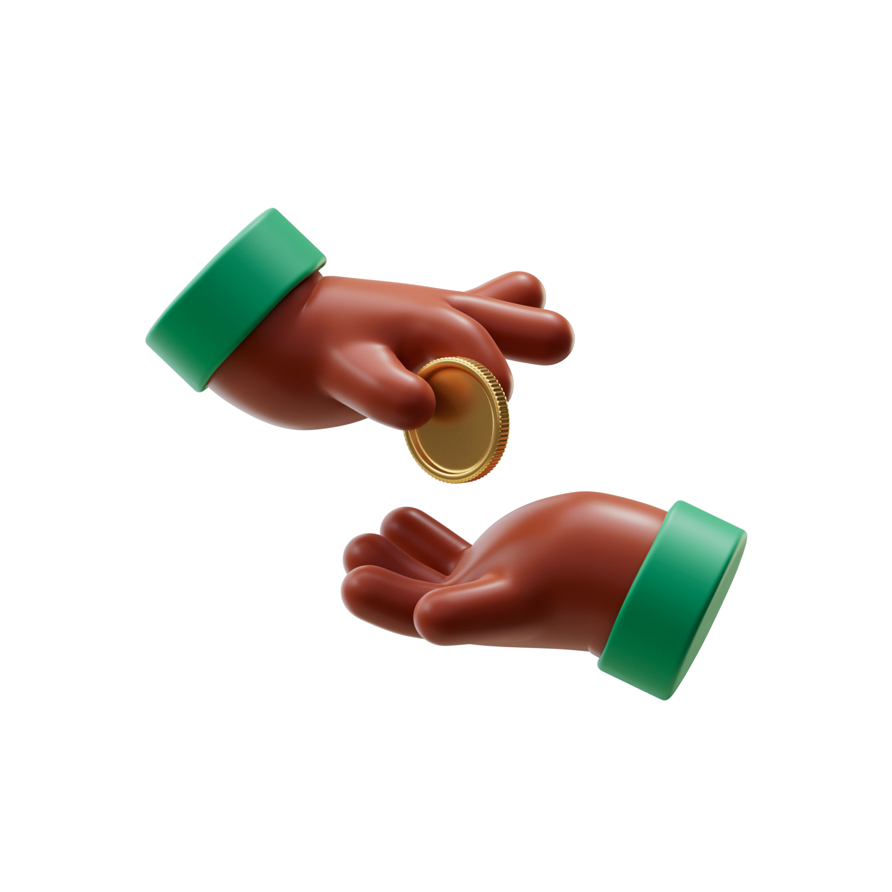
7. Strategic Recommendations 🗂️
4. Local Team
Hire a local General Manager with experience in mobility or tech startups in Barcelona.
5. Marketing Focus
- Heavy emphasis on digital marketing, targeting both locals and tourists - Sponsor local events to build brand awareness and community goodwil
6. Sustainability Narrative
Highlight CO2 savings (0.023 kg CO2eq/ride vs. cars) in all communications.
EMRE ÖZYÜREK

Slide 15
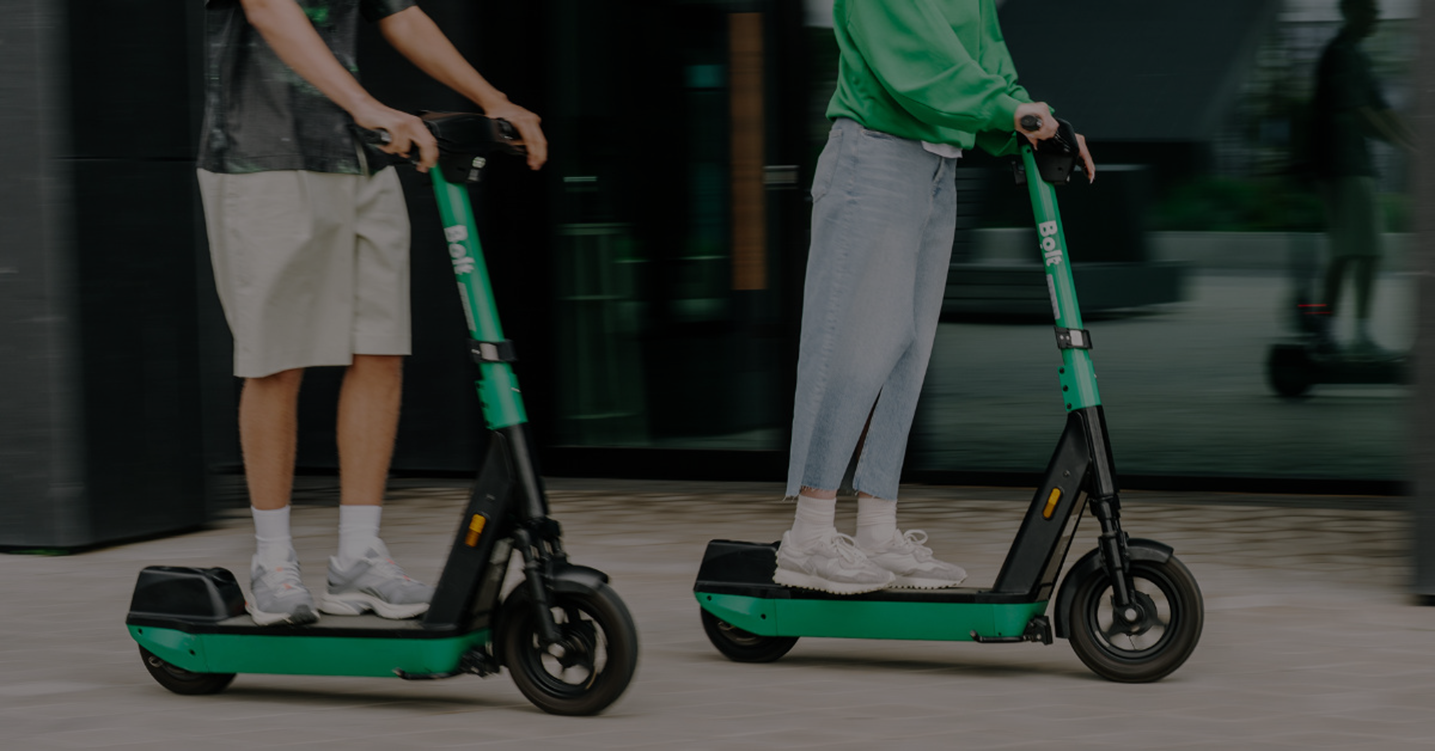

By executing this comprehensive strategy, Bolt can establish a strong presence in Barcelona's competitive e-scooter market, aiming for 20% market share and profitability within 18 months of launch.
EMRE ÖZYÜREK

Slide 16
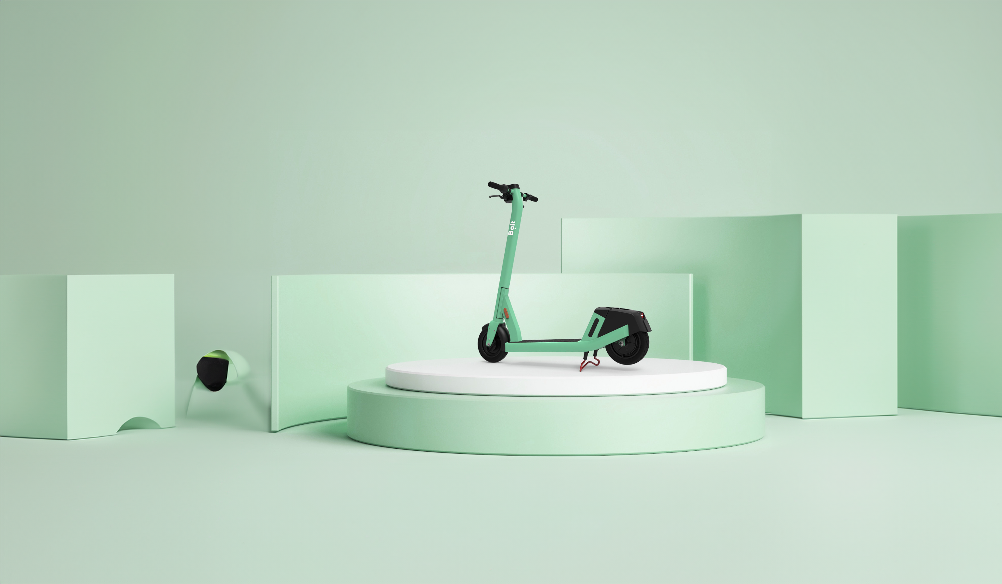
Thank You
Emre Özyürek

